Slide 1
Thermometer
Mini-Project
By Russell Chung, Pyson, and Ethan Wong

Slide 2
THERMOMETER
Defining Requirements, Interface, Implementation, Board Design

Slide 3
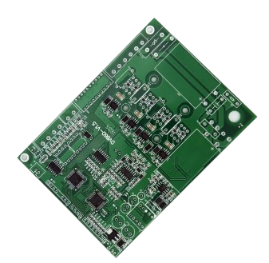
Defining Our Requirements
Assignment
  Designing a Thermometer Daughterboard That Can Be Implemented in the Phone
Defined Objective
  Designing a Thermometer Daughterboard to:
    Detect fevers
    Sense outdoor ambient temperature
    Measure steak surface temperature (idea is we could estimate the Internal Temperature)
System Context
  Part of a modular sensor daughterboard integrated with our FPGA-based SoC smartphone prototype
  Work within the same system as a Barometer

Slide 4
Our Requirements
Temperature Range: –25°C to 250°C
Accuracy: ±0.2°C (for medical-grade Fever detection)
Interface of Choice: I²C
  Analog
    Transmits continuous voltage signals that directly represent a physical quantity, such as temperature or light intensity. Analog sensors output a voltage proportional to the measured value, which the receiving system interprets through an analog-to-digital converter (ADC). This method uses one wire per sensor signal and requires careful calibration due to noise and voltage scaling.
  SPI
    Transfers data between a single master and one or more slave devices using four wires: serial clock (SCLK), master-out-slave-in (MOSI), master-in-slave-out (MISO), and chip select (CS). SPI is a high-speed, full-duplex protocol ideal for fast communication with peripherals like sensors, displays, or memory chips. Each slave device needs its own CS line.
  I²C
    Transfer data between a master (or multiple masters) and a single slave (or multiple slaves) device. It is a bidirectional two-wire serial bus that uses serial clock (SCL) and serial data (SDA) wires to send and manage data bit by bit between devices connected to the bus.
  UART
    Transfers data between two devices over two wires (TX for transmit, RX for receive) without needing a clock signal. UART uses start and stop bits to frame each data byte and requires both devices to agree on a communication speed (baud rate). It supports full-duplex communication but is limited to point-to-point connections (one-to-one).
Power Supply: 3.3V
Form Factor: Compact, aligns with daughterboard header
Notes:
✅ Why We Chose I²C for the Thermometer Module
1. 🧩 Multiple Sensors on One Bus
Your system includes more than one sensor (e.g., thermometer + barometer).
I²C supports multiple devices on the same two wires—each with a unique address.
This simplifies wiring and PCB routing, especially on a stacked daughterboard.
2. 🧠 Digital Accuracy and Stability
I²C transmits digital data, which means:
Higher precision and accuracy than analog voltage
No need for ADCs (analog-to-digital converters)
Less prone to signal noise or voltage drift
3. ⚡ Low Pin Count
Uses only 2 signal lines: SDA (data) and SCL (clock)
Saves pins on your MCU/FPGA and keeps the design compact
4. 🔌 Wide Sensor Ecosystem
Industry-standard for sensors like:
MCP9600 (thermocouple interface)
BMP581 (barometer)
TMP102, MCP9808, etc.
Readily supported in firmware libraries (Arduino, Python, Zephyr, Verilog wrappers)
5. 💻 Easier Firmware and Expansion
Works well with FPGA softcores or embedded MCUs
Easy to poll, scan, and expand with future sensors (e.g., accelerometer, humidity)
🚫 Why We Didn’t Use the Others:
Interface Reason Rejected
Analog Needs ADC, less accurate, more noise-sensitive
SPI More wires (4+), overkill for thermometer’s data rate
UART Point-to-point only, not scalable for multi-sensor bus
✅ TL;DR:
I²C was chosen because it’s simple, scalable, accurate, and already supported by the MCP9600. It also allows us to easily integrate other sensors (like the BMP581 barometer) on the same bus with minimal wiring and code complexity.

Slide 5
Sensor Selection Process
Understanding the Limitations of the Interface We Chose (I²C)
  I²C has addresses, so when there are multiple sensors from the same manufacturer, a lot of times there is an overlap causing conflicting data because data from both sensors gets sent on the same bus to SoC at the same time
    Our Solution For This was to Use a Thermocouple
We probably should have made a decision matrix which is a big no-no (don;t do what we did)
  However, the IC chip that we decided to use was the MCP9600T-E/MX
What is an IC chip?
  The MCP9600 is an interface IC that lets a microcontroller read temperature from a thermocouple by converting its tiny voltage into precise, digital temperature data—communicated via I²C.
    Reads a Thermocouple
    Does Math Conversion/Logic
    Communicates with Microcontroller or FPGA

Slide 6
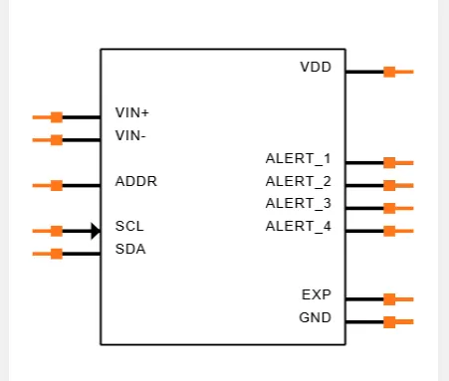
Thermocouple IC Pinout
MCP9600T-E/MX
  Ground Pin (GND) - System Ground; required for operation
  Voltage at the Drain (VDD) - VDD is the power pin. The operating voltage range, as specified in the DC Characteristics table, is applied on this pin.
  Thermocouple Input (V_{in +} and V_{in -}) - Connect thermocouple; measures voltage
  Alert Outputs (Alert 1–4): Temperature-triggered digital alerts
  I²C Address Pin (ADDR) - Sets I²C address level
  Serial Clock Line (SCL) - I²C Clock input from master
  Serial Data Line (SDA) - I²C bidirectional data line
Notes:
Absolutely! Here's a full explanation of each MCP9600 pin, written as speaker notes for use in your presentation—so you can explain them confidently without overwhelming the slide content.
🔌 3.1 Ground Pin (GND)
Speaker Notes:
These pins are the electrical ground reference for the entire chip. Pins 1, 3, 5, 13, and 17 are internally connected and sit at the same potential—any of them can be used as GND. However, pins 6, 7, 9, 10, and 18 must also be tied to ground externally for the MCP9600 to operate correctly. Think of this as ensuring stable and balanced grounding across the chip’s internal analog and digital subsystems.
🌡 3.2 Thermocouple Inputs (VIN+, VIN–)
Speaker Notes:
This is where the actual thermocouple wires connect. The positive wire goes to VIN+ and the negative to VIN–. The thermocouple generates a tiny voltage based on the temperature difference between its sensing end and the chip itself. The MCP9600 amplifies this signal, applies cold junction compensation (based on its own internal temperature sensor), and converts the result to °C digitally. This is the chip’s core sensing input.
⚡ 3.3 Power Pin (VDD)
Speaker Notes:
This is the main power supply pin for the chip. It typically operates at 3.3V (or up to 5V depending on your design). Make sure to supply clean, regulated voltage here—this powers everything, from the internal temperature compensation engine to the I²C communication interface. If this pin isn’t stable, you’ll likely get incorrect readings or communication failures.
🚨 3.4 Alert Outputs (Alert 1–4)
Speaker Notes:
These are optional programmable outputs that act like alarm pins. You can configure them via I²C to trigger if the temperature exceeds a certain threshold—or drops below it. They're “push-pull” style digital outputs, meaning they can drive high and low levels directly. You could connect them to an LED, a fan controller, or use them as interrupts to your MCU to take real-time action when overheating is detected.
🧠 3.5 I²C Address Pin (ADDR)
Speaker Notes:
This pin sets the chip’s I²C address so the host MCU or FPGA can uniquely identify and talk to it on the bus. You can tie it directly to GND, VDD, or connect it through a resistor divider to generate up to 8 distinct address levels. This is important when you’re using multiple MCP9600s on the same I²C bus—you’ll need each one to have a unique address.
⏱ 3.6 Serial Clock Line (SCL)
Speaker Notes:
This is the clock line used for I²C communication. It’s driven by the host controller (like an MCU or FPGA). All timing for sending and receiving data is based on this clock signal. The MCP9600 is an I²C slave—it listens to the host and responds only when it's addressed.
🔁 3.7 Serial Data Line (SDA)
Speaker Notes:
This is the bidirectional data line for I²C. Data is sent and received bit by bit along this line. The SDA and SCL lines must both have pull-up resistors (typically 4.7kΩ) for the I²C bus to function. The MCP9600 responds on SDA only when it’s addressed by the host and only during read/write cycles.

Slide 7
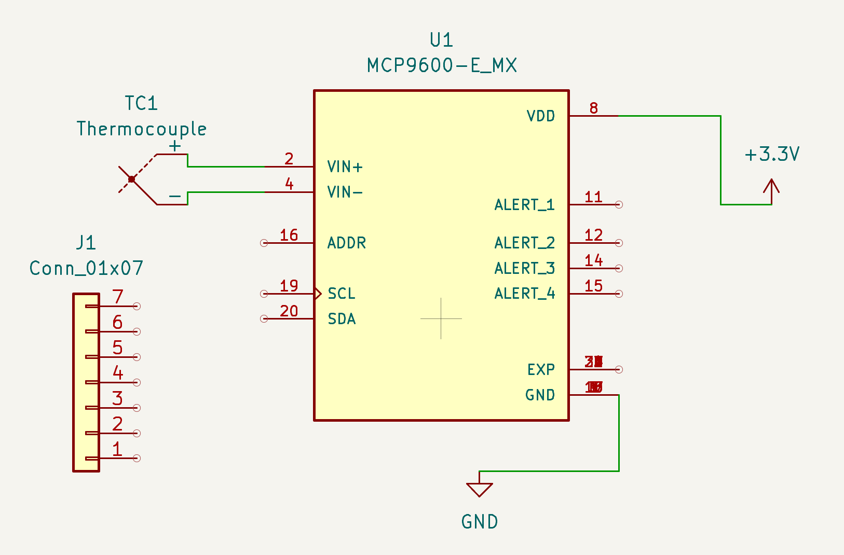
Our Daughter Board Design
Notes:
Absolutely! Here's a full explanation of each MCP9600 pin, written as speaker notes for use in your presentation—so you can explain them confidently without overwhelming the slide content.
🔌 3.1 Ground Pin (GND)
Speaker Notes:
These pins are the electrical ground reference for the entire chip. Pins 1, 3, 5, 13, and 17 are internally connected and sit at the same potential—any of them can be used as GND. However, pins 6, 7, 9, 10, and 18 must also be tied to ground externally for the MCP9600 to operate correctly. Think of this as ensuring stable and balanced grounding across the chip’s internal analog and digital subsystems.
🌡 3.2 Thermocouple Inputs (VIN+, VIN–)
Speaker Notes:
This is where the actual thermocouple wires connect. The positive wire goes to VIN+ and the negative to VIN–. The thermocouple generates a tiny voltage based on the temperature difference between its sensing end and the chip itself. The MCP9600 amplifies this signal, applies cold junction compensation (based on its own internal temperature sensor), and converts the result to °C digitally. This is the chip’s core sensing input.
⚡ 3.3 Power Pin (VDD)
Speaker Notes:
This is the main power supply pin for the chip. It typically operates at 3.3V (or up to 5V depending on your design). Make sure to supply clean, regulated voltage here—this powers everything, from the internal temperature compensation engine to the I²C communication interface. If this pin isn’t stable, you’ll likely get incorrect readings or communication failures.
🚨 3.4 Alert Outputs (Alert 1–4)
Speaker Notes:
These are optional programmable outputs that act like alarm pins. You can configure them via I²C to trigger if the temperature exceeds a certain threshold—or drops below it. They're “push-pull” style digital outputs, meaning they can drive high and low levels directly. You could connect them to an LED, a fan controller, or use them as interrupts to your MCU to take real-time action when overheating is detected.
🧠 3.5 I²C Address Pin (ADDR)
Speaker Notes:
This pin sets the chip’s I²C address so the host MCU or FPGA can uniquely identify and talk to it on the bus. You can tie it directly to GND, VDD, or connect it through a resistor divider to generate up to 8 distinct address levels. This is important when you’re using multiple MCP9600s on the same I²C bus—you’ll need each one to have a unique address.
⏱ 3.6 Serial Clock Line (SCL)
Speaker Notes:
This is the clock line used for I²C communication. It’s driven by the host controller (like an MCU or FPGA). All timing for sending and receiving data is based on this clock signal. The MCP9600 is an I²C slave—it listens to the host and responds only when it's addressed.
🔁 3.7 Serial Data Line (SDA)
Speaker Notes:
This is the bidirectional data line for I²C. Data is sent and received bit by bit along this line. The SDA and SCL lines must both have pull-up resistors (typically 4.7kΩ) for the I²C bus to function. The MCP9600 responds on SDA only when it’s addressed by the host and only during read/write cycles.

Slide 8
How Our Thermometer Works
V_{in} and V_{out}
  Voltage In and Out in this IC circuit is not bidirectional, so what we can do here is take the difference in voltage
V = IR and R_{f} = R₀(1 + αΔT)
  Resistance is Directly Proportional to Voltage, so a Voltage Difference Can Be Used to Calculate Resistance
  Temperature is Directly Proportional to Resistance, so a Resistance Difference Can Be Used to Calculate Temperature
IC Chip Does The Calculations
Notes:
Absolutely! Here's a full explanation of each MCP9600 pin, written as speaker notes for use in your presentation—so you can explain them confidently without overwhelming the slide content.
🔌 3.1 Ground Pin (GND)
Speaker Notes:
These pins are the electrical ground reference for the entire chip. Pins 1, 3, 5, 13, and 17 are internally connected and sit at the same potential—any of them can be used as GND. However, pins 6, 7, 9, 10, and 18 must also be tied to ground externally for the MCP9600 to operate correctly. Think of this as ensuring stable and balanced grounding across the chip’s internal analog and digital subsystems.
🌡 3.2 Thermocouple Inputs (VIN+, VIN–)
Speaker Notes:
This is where the actual thermocouple wires connect. The positive wire goes to VIN+ and the negative to VIN–. The thermocouple generates a tiny voltage based on the temperature difference between its sensing end and the chip itself. The MCP9600 amplifies this signal, applies cold junction compensation (based on its own internal temperature sensor), and converts the result to °C digitally. This is the chip’s core sensing input.
⚡ 3.3 Power Pin (VDD)
Speaker Notes:
This is the main power supply pin for the chip. It typically operates at 3.3V (or up to 5V depending on your design). Make sure to supply clean, regulated voltage here—this powers everything, from the internal temperature compensation engine to the I²C communication interface. If this pin isn’t stable, you’ll likely get incorrect readings or communication failures.
🚨 3.4 Alert Outputs (Alert 1–4)
Speaker Notes:
These are optional programmable outputs that act like alarm pins. You can configure them via I²C to trigger if the temperature exceeds a certain threshold—or drops below it. They're “push-pull” style digital outputs, meaning they can drive high and low levels directly. You could connect them to an LED, a fan controller, or use them as interrupts to your MCU to take real-time action when overheating is detected.
🧠 3.5 I²C Address Pin (ADDR)
Speaker Notes:
This pin sets the chip’s I²C address so the host MCU or FPGA can uniquely identify and talk to it on the bus. You can tie it directly to GND, VDD, or connect it through a resistor divider to generate up to 8 distinct address levels. This is important when you’re using multiple MCP9600s on the same I²C bus—you’ll need each one to have a unique address.
⏱ 3.6 Serial Clock Line (SCL)
Speaker Notes:
This is the clock line used for I²C communication. It’s driven by the host controller (like an MCU or FPGA). All timing for sending and receiving data is based on this clock signal. The MCP9600 is an I²C slave—it listens to the host and responds only when it's addressed.
🔁 3.7 Serial Data Line (SDA)
Speaker Notes:
This is the bidirectional data line for I²C. Data is sent and received bit by bit along this line. The SDA and SCL lines must both have pull-up resistors (typically 4.7kΩ) for the I²C bus to function. The MCP9600 responds on SDA only when it’s addressed by the host and only during read/write cycles.

Slide 9
Our Daughter Board Design
Notes:
Absolutely! Here's a full explanation of each MCP9600 pin, written as speaker notes for use in your presentation—so you can explain them confidently without overwhelming the slide content.
🔌 3.1 Ground Pin (GND)
Speaker Notes:
These pins are the electrical ground reference for the entire chip. Pins 1, 3, 5, 13, and 17 are internally connected and sit at the same potential—any of them can be used as GND. However, pins 6, 7, 9, 10, and 18 must also be tied to ground externally for the MCP9600 to operate correctly. Think of this as ensuring stable and balanced grounding across the chip’s internal analog and digital subsystems.
🌡 3.2 Thermocouple Inputs (VIN+, VIN–)
Speaker Notes:
This is where the actual thermocouple wires connect. The positive wire goes to VIN+ and the negative to VIN–. The thermocouple generates a tiny voltage based on the temperature difference between its sensing end and the chip itself. The MCP9600 amplifies this signal, applies cold junction compensation (based on its own internal temperature sensor), and converts the result to °C digitally. This is the chip’s core sensing input.
⚡ 3.3 Power Pin (VDD)
Speaker Notes:
This is the main power supply pin for the chip. It typically operates at 3.3V (or up to 5V depending on your design). Make sure to supply clean, regulated voltage here—this powers everything, from the internal temperature compensation engine to the I²C communication interface. If this pin isn’t stable, you’ll likely get incorrect readings or communication failures.
🚨 3.4 Alert Outputs (Alert 1–4)
Speaker Notes:
These are optional programmable outputs that act like alarm pins. You can configure them via I²C to trigger if the temperature exceeds a certain threshold—or drops below it. They're “push-pull” style digital outputs, meaning they can drive high and low levels directly. You could connect them to an LED, a fan controller, or use them as interrupts to your MCU to take real-time action when overheating is detected.
🧠 3.5 I²C Address Pin (ADDR)
Speaker Notes:
This pin sets the chip’s I²C address so the host MCU or FPGA can uniquely identify and talk to it on the bus. You can tie it directly to GND, VDD, or connect it through a resistor divider to generate up to 8 distinct address levels. This is important when you’re using multiple MCP9600s on the same I²C bus—you’ll need each one to have a unique address.
⏱ 3.6 Serial Clock Line (SCL)
Speaker Notes:
This is the clock line used for I²C communication. It’s driven by the host controller (like an MCU or FPGA). All timing for sending and receiving data is based on this clock signal. The MCP9600 is an I²C slave—it listens to the host and responds only when it's addressed.
🔁 3.7 Serial Data Line (SDA)
Speaker Notes:
This is the bidirectional data line for I²C. Data is sent and received bit by bit along this line. The SDA and SCL lines must both have pull-up resistors (typically 4.7kΩ) for the I²C bus to function. The MCP9600 responds on SDA only when it’s addressed by the host and only during read/write cycles.

Slide 10
Sources
Notion:
https://www.notion.so/Thermometer-21e169473d778007bf46e3cce8d5c230?source=copy_link
Datasheet:
https://s3.amazonaws.com/snapeda/datasheet/MCP9600-E/MX_Microchip.pdf
https://www.notion.so/Recorded-Meetings-23a169473d7780039354ecdf9b171754?source=copy_link
Notes:
Absolutely! Here's a full explanation of each MCP9600 pin, written as speaker notes for use in your presentation—so you can explain them confidently without overwhelming the slide content.
🔌 3.1 Ground Pin (GND)
Speaker Notes:
These pins are the electrical ground reference for the entire chip. Pins 1, 3, 5, 13, and 17 are internally connected and sit at the same potential—any of them can be used as GND. However, pins 6, 7, 9, 10, and 18 must also be tied to ground externally for the MCP9600 to operate correctly. Think of this as ensuring stable and balanced grounding across the chip’s internal analog and digital subsystems.
🌡 3.2 Thermocouple Inputs (VIN+, VIN–)
Speaker Notes:
This is where the actual thermocouple wires connect. The positive wire goes to VIN+ and the negative to VIN–. The thermocouple generates a tiny voltage based on the temperature difference between its sensing end and the chip itself. The MCP9600 amplifies this signal, applies cold junction compensation (based on its own internal temperature sensor), and converts the result to °C digitally. This is the chip’s core sensing input.
⚡ 3.3 Power Pin (VDD)
Speaker Notes:
This is the main power supply pin for the chip. It typically operates at 3.3V (or up to 5V depending on your design). Make sure to supply clean, regulated voltage here—this powers everything, from the internal temperature compensation engine to the I²C communication interface. If this pin isn’t stable, you’ll likely get incorrect readings or communication failures.
🚨 3.4 Alert Outputs (Alert 1–4)
Speaker Notes:
These are optional programmable outputs that act like alarm pins. You can configure them via I²C to trigger if the temperature exceeds a certain threshold—or drops below it. They're “push-pull” style digital outputs, meaning they can drive high and low levels directly. You could connect them to an LED, a fan controller, or use them as interrupts to your MCU to take real-time action when overheating is detected.
🧠 3.5 I²C Address Pin (ADDR)
Speaker Notes:
This pin sets the chip’s I²C address so the host MCU or FPGA can uniquely identify and talk to it on the bus. You can tie it directly to GND, VDD, or connect it through a resistor divider to generate up to 8 distinct address levels. This is important when you’re using multiple MCP9600s on the same I²C bus—you’ll need each one to have a unique address.
⏱ 3.6 Serial Clock Line (SCL)
Speaker Notes:
This is the clock line used for I²C communication. It’s driven by the host controller (like an MCU or FPGA). All timing for sending and receiving data is based on this clock signal. The MCP9600 is an I²C slave—it listens to the host and responds only when it's addressed.
🔁 3.7 Serial Data Line (SDA)
Speaker Notes:
This is the bidirectional data line for I²C. Data is sent and received bit by bit along this line. The SDA and SCL lines must both have pull-up resistors (typically 4.7kΩ) for the I²C bus to function. The MCP9600 responds on SDA only when it’s addressed by the host and only during read/write cycles.

